Slide 1
part 1
lab session
Condition

Slide 2
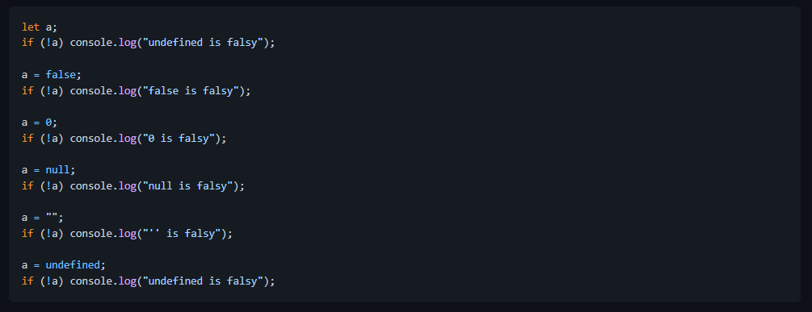
Lab 3a: Test for falsy condition
Create and run the file 3a-falsy.js.
Note: The ! operator means NOT. We can use if (!a)... to test if a result is false. The following code will show all results where a is treated as false.

Slide 3
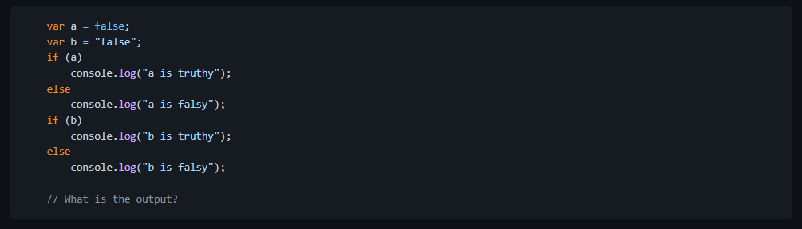
Lab 3b: Misinterpreting Falsy Condition
The purpose of this lab is to becareful of the interpretation of true and false conditions when writing Javascript.
1. Create and run the file 3b-falsy.js
Why is b not falsy?

